Slide 1
C++ Programming Today 2nd Edition By Barbara Johnston Chapter 6
Instructor: <Instructor Name>
Lecture Slides by Kelly Montoya and Rob Garner

Slide 2
Chapter 6
Array Fundamentals
Loops and Arrays
Array Declaration and Initialization
Array Out of Bounds
Vectors and Arrays
Arrays and Functions
Example using Arrays and Functions
Character Arrays
Character Array Initialization
The Null Character
Character Array
Data Structures
Filling Arrays from Data Files
The ifstream and ofstream Classes
Using Char Delimiters with GetLine
Parsing Strings
Converting Strings to Numbers
Multi-dimensional Arrays
Two-Dimensional Array Initialization
Nested for Loops and Two-Dimensional Arrays
Multi-dimensional Arrays and Functions
Common Errors With Arrays

Slide 3
Character Arrays
Explain how to use character arrays

Slide 4
character arrays, AKA Character Arrays
In the “old days”, C programmers had to use character arrays to hold their text data.
The character array is a one-dimensional character array, which is null-terminated.
The character array contains the characters and has an ASCII zero value, known as the null character (‘\0’, read as “backslash zero”), at the end of the data.
This null character indicates the end of the text data.

Slide 5
The basic format for declaring a null-terminated character string is:
char variableName[size];
char name[50];
char fileName[40];
char zip[15];
The char data type has one byte per element.
Always remember to make your character arrays big enough to include the null character.

Slide 6
Declare a character array called studentName that can hold up to 75 characters.

Slide 7
Character Array Initialization
Explain how to initialize a character array

Slide 8
Character Array Initialization
Initializing character Arrays follows the same format as initializing numeric valued arrays.
It is possible to initialize this Array by using the comma-separated list as well as a string constant.
Here we initialize the character array to contain “I love C++!”
When you declare and initialize a character array in this manner, the null character is automatically added.

Slide 9

NULL characters are inserted automatically.
I
l
o
v
e
C
+
+
!
\0
\0
\0
\0
\0
line[0]
line[14]
line[1]
Initializing a character array, nulls are added to the unused elements.

Slide 10
Declare a character array called studentName that can hold up to 75 characters and initialize it to your name.

Slide 11
The Null Character
Explain the purpose of the Null Character in character arrays

Slide 12
The Null Character
C++ uses the null character to indicate where the end of the data is located.
For most of your day-to-day work with character arrays, the null character is placed into the array automatically.
It is important to remember that all of the character array functions provided in the string library and the output functions in iostream require a null character at the end of the relevant data in order for your program to work correctly.
Notes:
Program 6-7 shows how important the null character is when writing character data to the screen (or to a data file).

Slide 13
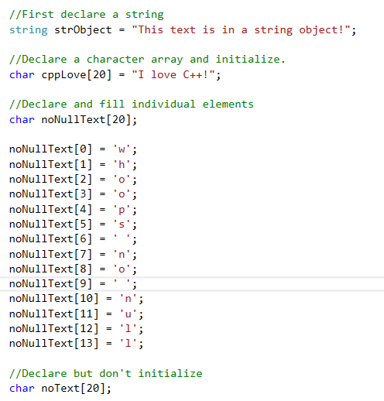
How the four data items are stored in memory.
noText
noNullText
cppLove
strObject
whoops no null
I Love C++’\0’
This is ….
trash
trash
null char

Slide 14
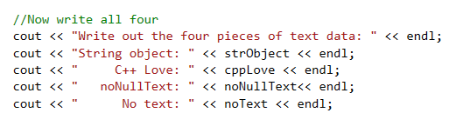
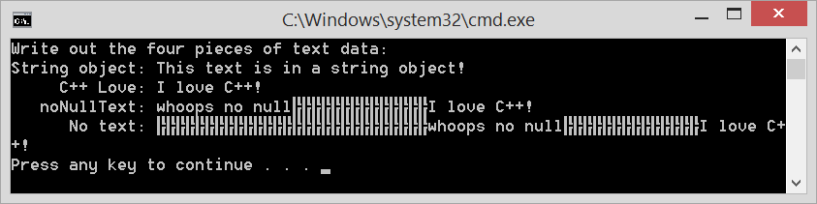
Declarations
When we try to write the noNullText array, cout writes characters until it sees a null character.
Same with noText array
How the four data items are stored in memory.
noText
noNullText
cppLove
strObject
whoops no null
I Love C++’\0’
This is ….
trash
trash
null char
Writes until it sees ‘\0’

Slide 15
The Null Character
When we try to write the noText array, cout writes characters until it sees a null character.
Thus we see 20 “trash” characters, then “Whoops no null”, then 6 “trash” characters, then “I love C++”.
There is a null character at the end of the cppLove character array—which cout uses as the stopping point.

Slide 16
The Null Character
The same thing happens with the noNullText array.
The null character indicates the end of the data in a character array.
Whenever you see these “trash” characters
╠╠╠╠╠╠╠╠╠╠╠
in your output (either screen or file) you are writing character array data that does not have the null character, ‘\0’ at the end of the data.

Slide 17
Character Array Input
Explain how to input character arrays

Slide 18
Character Array Input
The technique for reading data into character arrays is almost identical to those for reading data into C++ string objects.
The rules for cin and getline() hold true when reading character array data.
The prototype of getline() for character arrays is:
cin.getline(char* text ,int max);

Slide 19
The first parameter is the name of the array.
The second parameter is the size of the array.
The getline() function reads until it sees an Enter key, or until it has read (max-1) chars into the array.
The code looks like this:
char name[50];
cout << “\n Enter your full name. ”;
cin.getline(name, 50);
Notes:
Program 6-8 reads data using getline and cin.

Slide 20
Write the code that will input a name into a 75 element character array called studentName.

Slide 21
Character Array Functions Provided in C++
Describe character string functions provide in C++

Slide 22
Character Array Functions Provided in C++
C++ provides several useful functions for working with character arrays.
These functions provide the tools for copying, concatenation, comparison, searching, etc.
The prototypes for the character array functions show character pointers as input ( char* ).

Slide 23
The table illustrates the prototype and call statements for these functions.

Slide 24
Notes:
Program 6-10 shows a few of these character array functions in action.

Slide 25
Demo
Demonstrate how to create character arrays

Slide 26
Chapter 6
Array Fundamentals
Loops and Arrays
Array Declaration and Initialization
Array Out of Bounds
Vectors and Arrays
Arrays and Functions
Example using Arrays and Functions
Character Arrays
Character Array Initialization
The Null Character
Character Array
Data Structures
Filling Arrays from Data Files
The ifstream and ofstream Classes
Using Char Delimiters with GetLine
Parsing Strings
Converting Strings to Numbers
Multi-dimensional Arrays
Two-Dimensional Array Initialization
Nested for Loops and Two-Dimensional Arrays
Multi-dimensional Arrays and Functions
Common Errors With Arrays

